Slide 1

College Major and Career Exploration
Abhishek Mahajan, Gregory Glatzer,
Hojin Ryoo, Pranay Muthineni

Slide 2
Objective
Using the PUMS recent-grads dataset, we will build a machine learning model that can predict a salary based on one’s major and career.

Slide 3
EDA

Slide 4
Unemployment Rates by Major
10 lowest
10 highest
EDUCATIONAL ADMINISTRATION AND SUPERVISION | 0%
MILITARY TECHNOLOGIES, | 0%
BOTANY | 0%
MATHEMATICS AND COMPUTER SCIENCE | 0 %
SOIL SCIENCE | 0 %
ENGINEERING MECHANICS PHYSICS AND SCIENCE | .633%
COURT REPORTING | 1.169%
MATHEMATICS TEACHER EDUCATION | 1.620%
PETROLEUM ENGINEERING | 1.838%
GENERAL AGRICULTURE | 1.964%
ARCHITECTURE | 11.333%
GEOGRAPHY | 11.345%
COMPUTER PROGRAMMING AND DATA PROCESSING | 11.398%
MINING AND MINERAL ENGINEERING | 11.724%
COMMUNICATION TECHNOLOGIES | 11.951%
PUBLIC POLICY | 12.842%
CLINICAL PSYCHOLOGY | 14.904%
COMPUTER NETWORKING AND TELECOMMUNICATIONS | 15.184%
PUBLIC ADMINISTRATION | 15.949%
NUCLEAR ENGINEERING | 17.722%

Slide 5
Median Salary by Major
5 lowest
5 highest
Psychology & Social Work | $30100.00
Humanities & Liberal Arts | $31913.33
Education | $31913.33
Arts | $33062.50
Communications & Journalism | $34500.00
Engineering | $57382.75
Business | $43538.46
Computers & Mathematics | $42745.45
Law & Public Policy | $42200.00
Physical Sciences | $41890.00
Given that there are no extremely high IQRs, we don’t need to normalize our data, as there are no features with very high standard deviations.

Slide 6
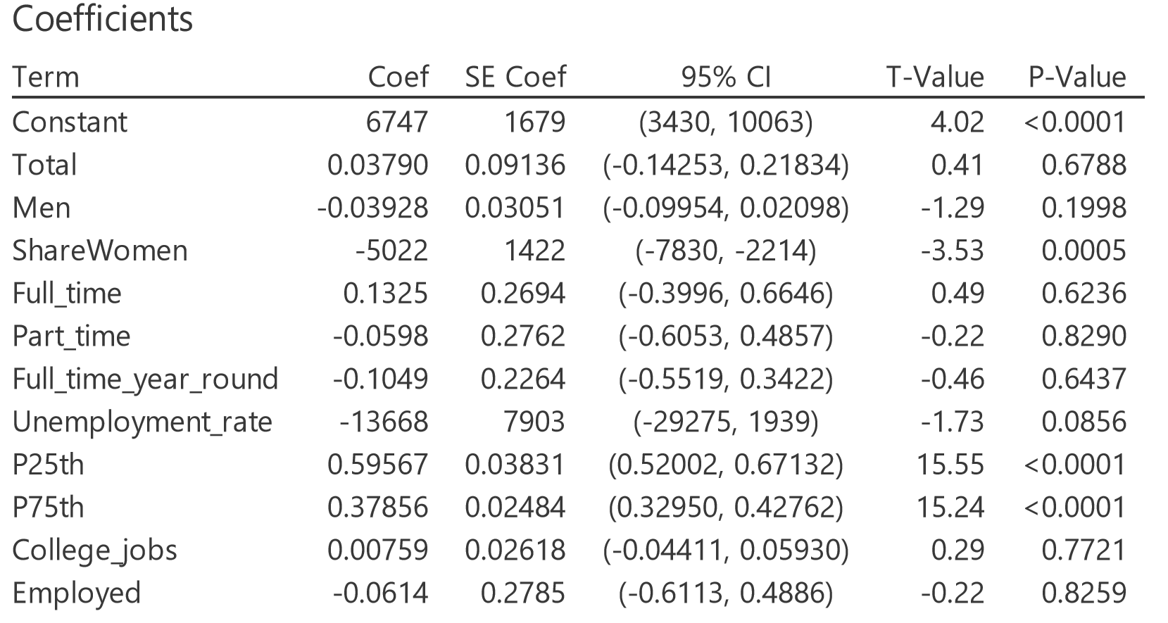
Adding relevant features

Slide 7
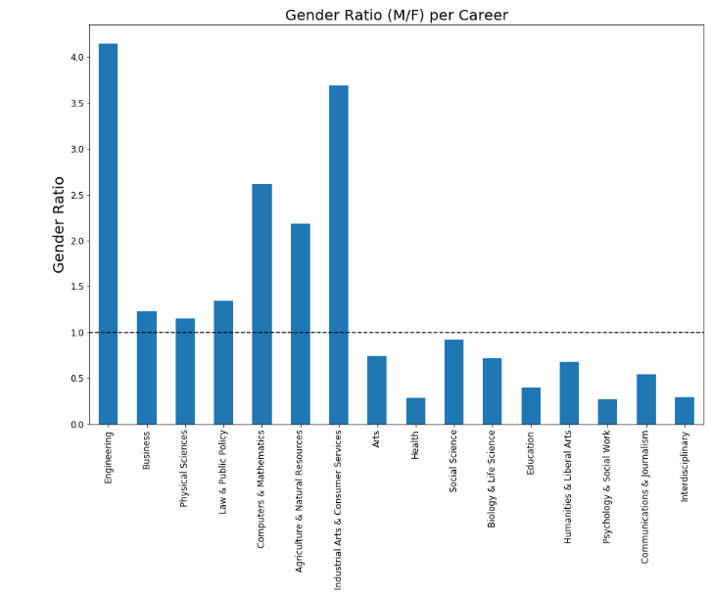
Adding relevant features

Slide 8
Linear Regression Model
Notes:
One of the challenges we encountered with this model, was that one of our career variable is categorical. With this regression model categorical variables cannot be entered into this model. We used “one-hot encoding” for our career variable to

Slide 9
Logistic Regression Model

Slide 10
Model Evaluation
Using RMSE as our metric of choice, a Linear Regression model outperformed a Logistic Regression model.
Most important features to predict Median salary
Employed
College_jobs
Gender_Ratio
Career
RMSE: 5879.62.

Slide 11
Challenges

